Slide 1
DS201 Spring 2020 -
Final Data Project
Part 1 - Project plan
Team YMN
Where It Pays to Attend College
Yen Vo
Matthew Shock
Nicole Duff

Slide 2

Stage 1: Ask A Question
What is the dataset-The dataset for our project is Where It Pays to Attend College. The data is taken from the Wall Street Journal is based on information from Payscale.com. The dataset contains information about salaries for graduates of universities based on the type of college, region, and major. The questions we seek to answer include:
Which type of school (party school, liberal arts school, state school) results in the highest salary for graduates?
Which major has the highest salary potential? Which major experiences the highest growth in salary?
Which region of the United States has the highest salary potential?
Can we predict future earnings and choice of college type ?
This project will provide several benefits for its users.
Future students planning for college can use the project to choose a university and major that will give them the highest salary when they graduate.
Current employees can use the project results to estimate their salary based on their school, region, and major.

Slide 3
Stage 2: Get the Data
How you get your data?
Kaggle
How you clean your data?
After importing cvs file to jupyter notebook, we checked type of salary . Because the salary variables are strings, meaning that we cannot make any calculations. All of them need to be converted to numerical values and the dollar sign needs to be removed. We checked for null values, but we did not find any.
How did you prepare it?
We checked type of salary and convert it to float, we also changed column names to make it easy to access later.

Slide 4
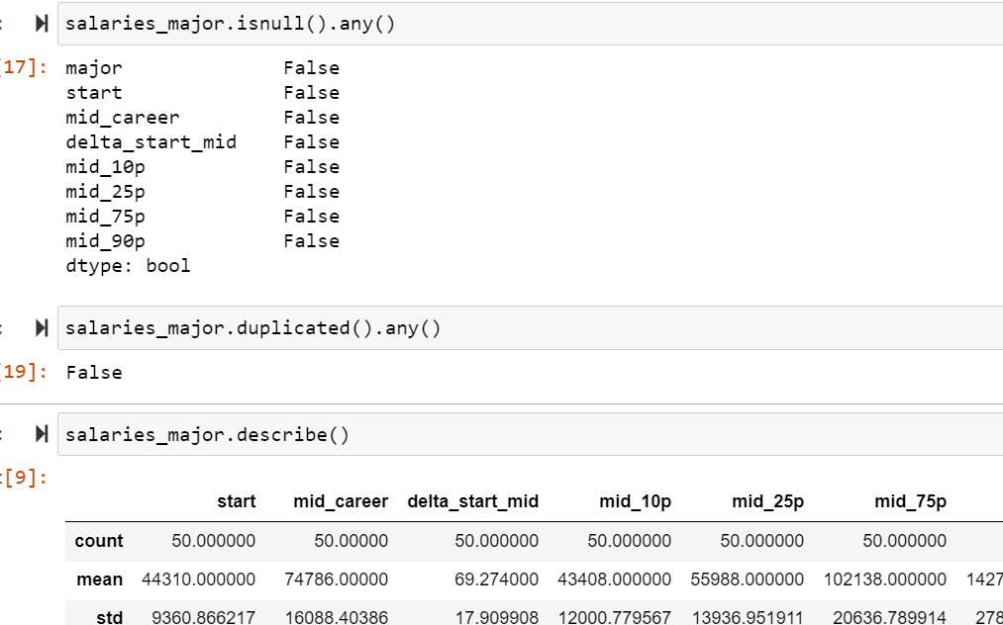
Stage 2: Get the data
We checked null and duplicate values in the data

Slide 5
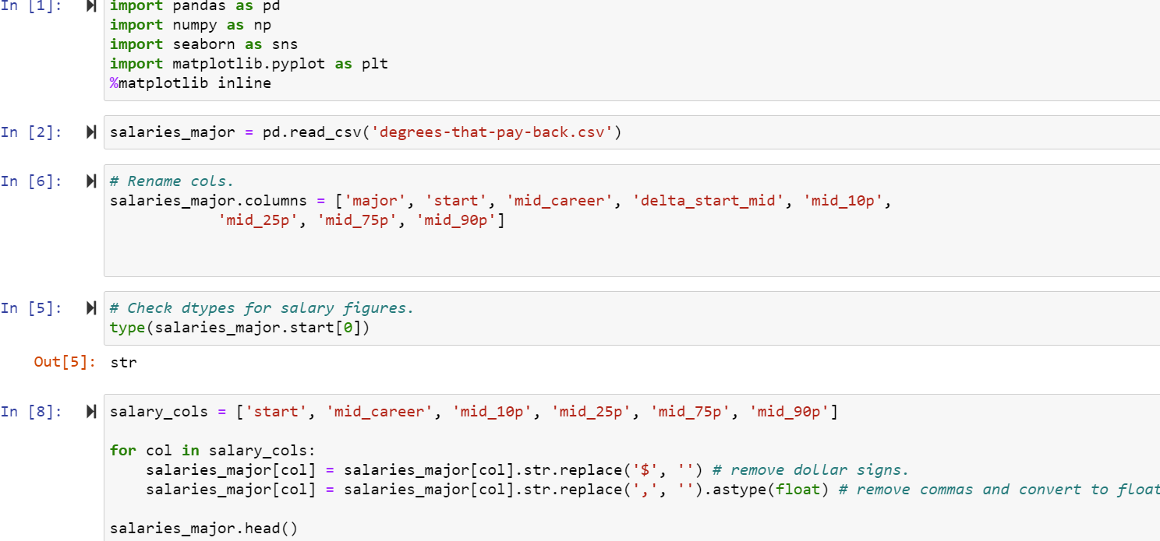
Stage 2: Get the Data- Rename Columns and Remove Symbols

Slide 6
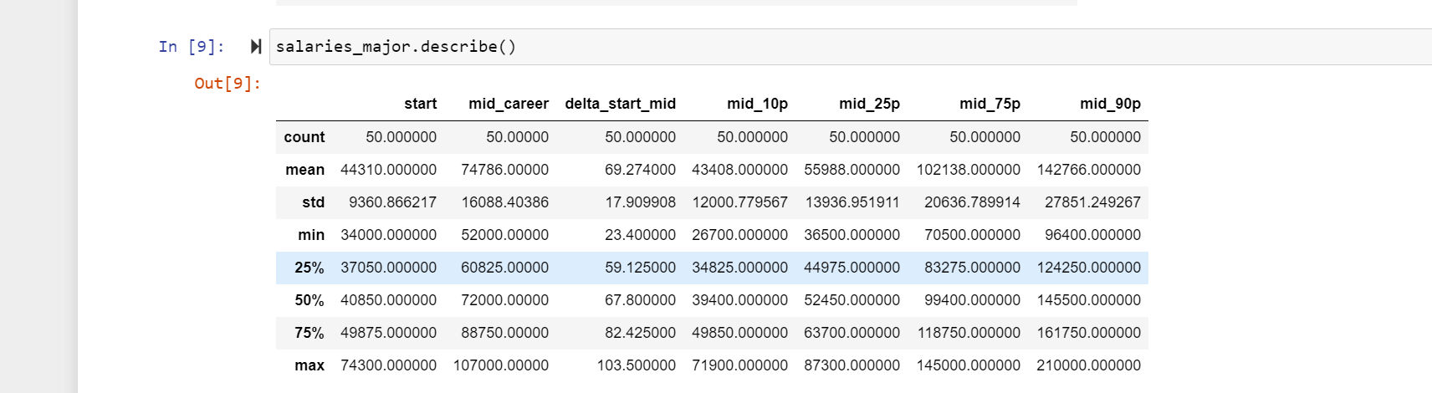
Stage 3: Explore the Data:
Descriptive analysis
We use salaries_major.describe() function to look at descriptive analysis

Slide 7
Stage 3: Explore the Data:
The mean starting salary for all graduates regardless of major is 44,310 USD.
The major with the highest mean starting salary earns 74,300 USD, while the major with the lowest mean starting salary earns 34,000 USD.
The mean mid-career salary for all college graduates regardless of major is 74,786 USD.
The major with the highest mean mid-career salary earns 107,000 USD, while the major with the lowest mean mid-career salary earns 52,000 USD.

Slide 8
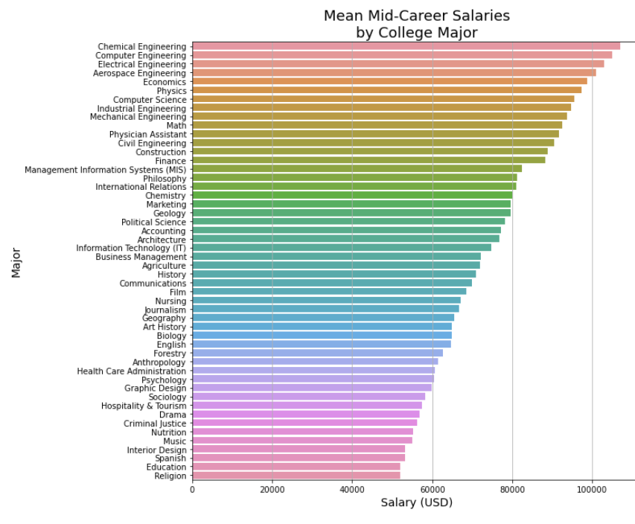
Horizontal Bar Chart highlighting which majors have the highest mid-career salaries on average.
By : Kaggle User Alex Kelso

Slide 9
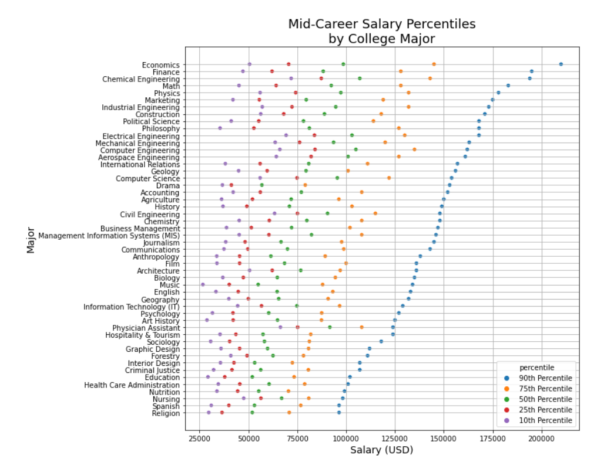
Scatterplot indicating growth among differing majors. Depicts relationships among a major versus others.
By: Kaggle User Alex Kelso

Slide 10
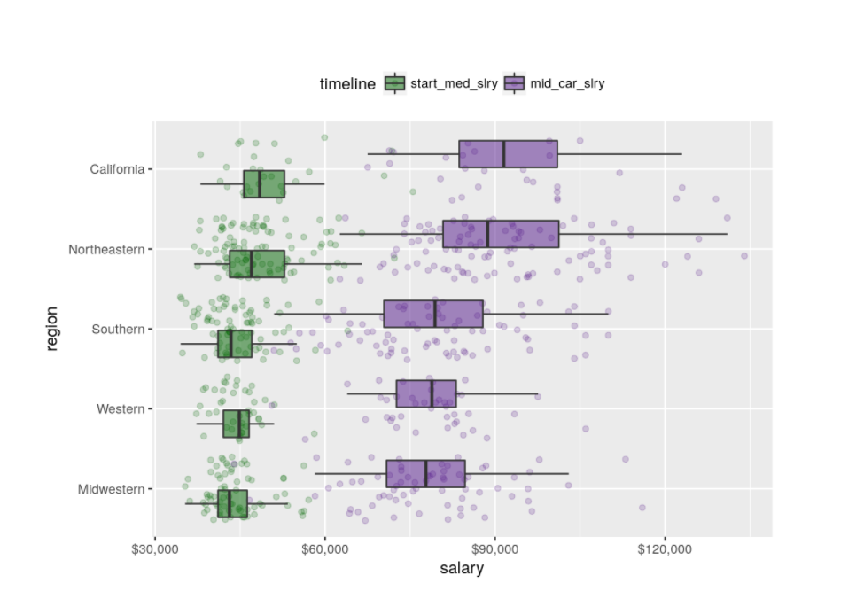
Box Plot indicating starting and mid-career salary on average based on different regions.
By: Kaggle User cbhyphen

Slide 11
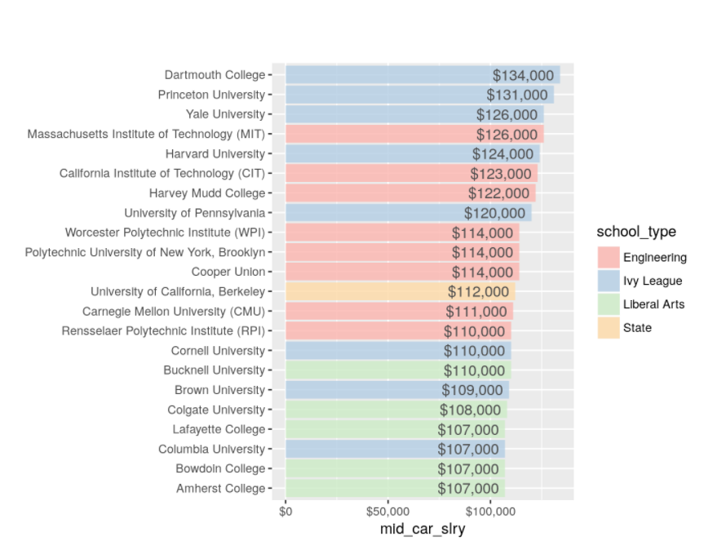
Here is a horizontal bar chart that shows average mid career salary. The different colors are based on the type of school the university is classified by.
By: Kaggle User cbhyphen

Slide 12
Stage 3: Hypothesis
H_{O}: There is no difference in salary in which region a college is located in.
H_{A}: There is a difference in salary in which region a college is located in.
H_{O}: There is no difference in salary in which type of college a student attends.
H_{A}: There is a difference in salary in which type of college a student attends.
Problems: Does not show outliers
Does not show how many observations of each column, this dataset includes means
Only includes students who participated in the survey
Dataset is four years old, potential for technology and new majors that would affect this dataset

Slide 13
Stage 4: Model the Data- Mean Starting Salaries by Major
Use Seaborn to Create Bar Chart of Salaries
Bar plot for starting salaries by major.
plt.figure(figsize = (10, 10))
sns.barplot(x = degree.sort_values('start', ascending = False).start, # Put data in descending order by start salary.
y = degree.sort_values('start', ascending = False).major) # Makes the graph easier to interpret.
plt.title('Mean Starting Salaries\nby College Major', fontsize = 12)
plt.xlabel('Salary (USD)', fontsize = 14)
plt.ylabel('Major', fontsize = 14)
plt.grid(axis = 'x')

Slide 14
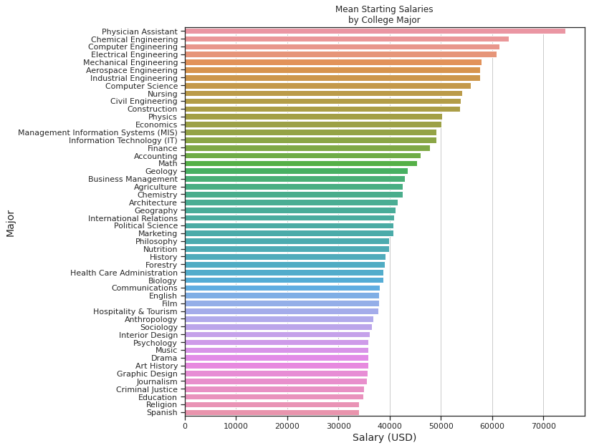

Slide 15
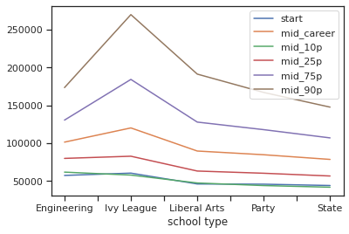
View Schools by Type
#To view the number of schools by type:
college_type["school type"].value_counts()
df = college_type[['start','mid_career','mid_10p', 'mid_25p', 'mid_75p', 'mid_90p','school type']]
var = df.groupby('school type').mean()
var.plot(kind='line');

Slide 16
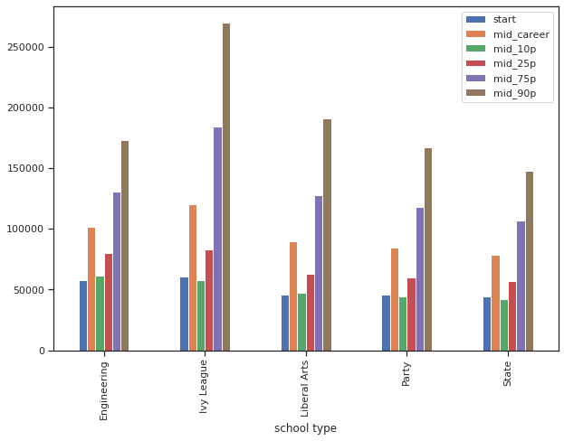
Salaries by School Type
#Salaries group by school Type
college_type.groupby('school type').mean().plot(kind = 'bar', figsize = (10,7))

Slide 17
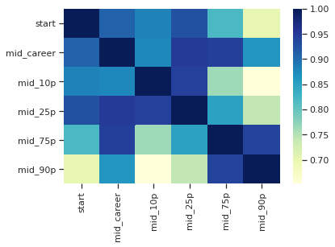
Correlation Heatmap
corr = college_type.corr()
corr = (corr)
sns.heatmap(corr,
xticklabels=corr.columns.values,
yticklabels=corr.columns.values,cmap="YlGnBu")
plt.show()

Slide 18
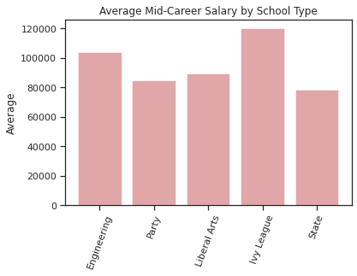
Mid-Career Salary by School Type
#A bar plot of the average Mid-Career Salary by school type
objects = ('Engineering', 'Party',' Liberal Arts' ,'Ivy League','State')
y_pos = np.arange(len(objects))
performance = [103842,84685,89379,120125,78567]
plt.bar(y_pos, performance, align='center', alpha=0.5, color='r')
plt.xticks(y_pos, objects, rotation='70')
plt.ylabel('Average')
plt.title('Average Mid-Career Salary by School Type')
plt.show()

Slide 19
Top Colleges with Highest Pay
# List of colleges ensuring highest pay from the type of school/college
Feature = []
school = []
Med_sal = []
v_features = college_type['school type'].value_counts().index
for i, cn in enumerate(v_features):
Feature.append(str(cn))
filtered = college_type[(college_type['school type']==str(cn))]
temp = filtered[filtered['mid_career'] == filtered['mid_career'].max()]['school name'].values
temp1 = temp[0]
tempval = filtered['mid_career'].max()
school.append(temp1)
Med_sal.append(tempval)
f, ax = plt.subplots(figsize=(15, 7))
g = sns.barplot( y = Feature,
x = Med_sal,palette="GnBu_d")
plt.title("Top colleges from each School type ensuring highest pay")
for i, v in enumerate(school):
ax.text(.5, i, v,fontsize=16,color='white',weight='bold')
fig=plt.gcf()
plt.show()

Slide 20
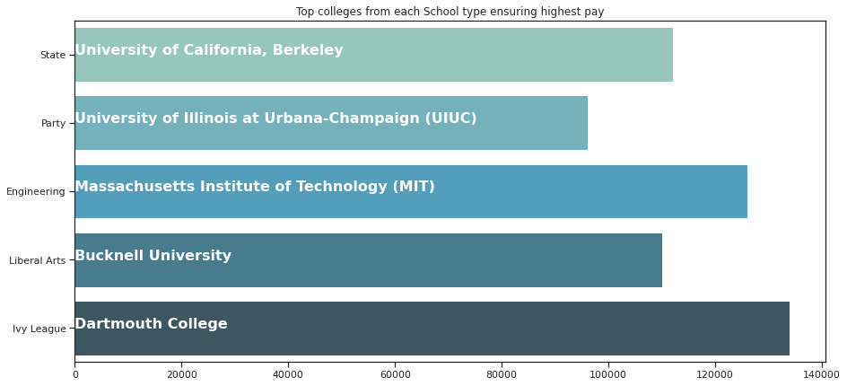

Slide 21
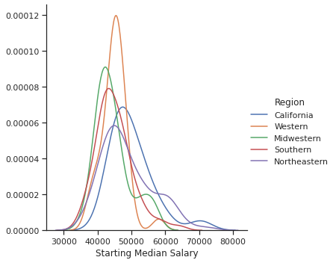
Region by Starting Salary
sns.FacetGrid(region, hue="Region", size=5) \
.map(sns.kdeplot, "Starting Median Salary") \
.add_legend()
plt.show()

Slide 22
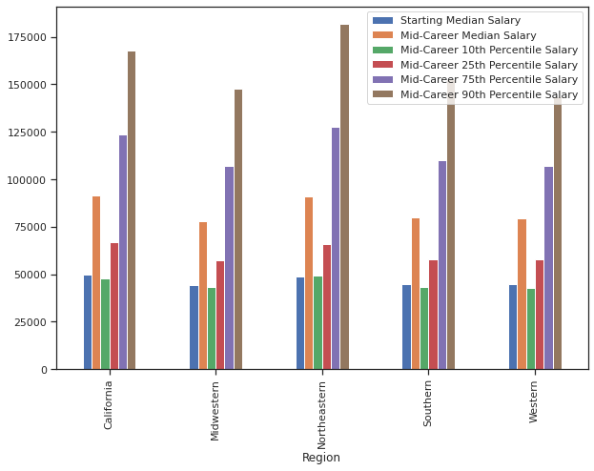
Salaries by Region
region.groupby('Region').mean().plot(kind = 'bar', figsize = (10, 7))

Slide 23
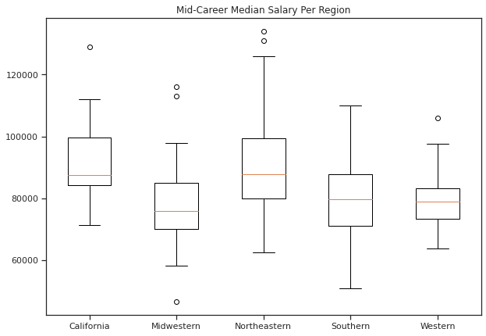
Mid-Career Salary by Region
data = [region[region.Region == 'California']['Mid-Career Median Salary'], region[region.Region == 'Midwestern']['Mid-Career Median Salary'],
region[region.Region=='Northeastern']['Mid-Career Median Salary'], region[region.Region == 'Southern']['Mid-Career Median Salary'],
region[region.Region=='Western']['Mid-Career Median Salary']]
plt.figure(figsize=(10,7))
plt.title('Mid-Career Median Salary Per Region')
labels=['California', 'Midwestern', 'Northeastern', 'Southern', 'Western']
boxplot = plt.boxplot(data, labels=labels)

Slide 24
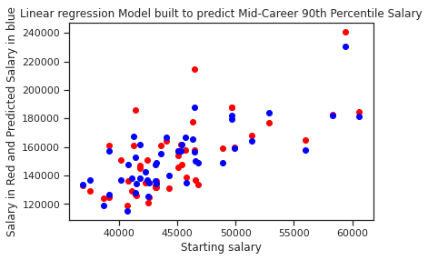
Regression Model
from sklearn.linear_model import LinearRegression
regressor = LinearRegression()
regressor.fit(X_train, y_train)
# Predicting the Test set results
y_pred = regressor.predict(X_test)
#y_pred
plt.scatter(X_test['start'],y_test,color='red')
plt.scatter(X_test['start'],regressor.predict(X_test),color='blue')
plt.title('Linear regression Model built to predict Mid-Career 90th Percentile Salary')
plt.xlabel('Starting salary')
plt.ylabel('Salary in Red and Predicted Salary in blue');

Slide 25
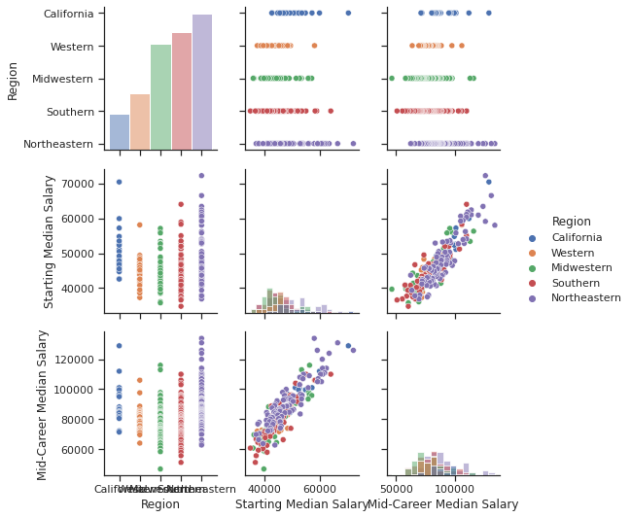
Region Pariplot
import seaborn as sns
sns.pairplot(region, vars=['Region', 'Starting Median Salary', 'Mid-Career Median Salary'], hue='Region', diag_kind='hist')
plt.show()

Slide 26
Region Bokeh
#prepare data
from bokeh.models import ColumnDataSource, CDSView, GroupFilter
source= ColumnDataSource(region)
#generate output
from bokeh.io import output_notebook, show
output_notebook()
#generate plot
from bokeh.plotting import figure
p= figure(title= 'Starting Salary by Region')
#add renderers
California= CDSView(source= source, filters= [GroupFilter(column_name='Region', group='California')])
Western= CDSView(source= source, filters= [GroupFilter(column_name='Region', group='Western')])
Midwestern= CDSView(source= source, filters= [GroupFilter(column_name='Region', group='Midwestern')])
Southern= CDSView(source= source, filters= [GroupFilter(column_name='Region', group='Southern')])
Northeastern= CDSView(source= source, filters= [GroupFilter(column_name='Region', group='Northeastern')])
p.circle('Starting Median Salary', 'Mid-Career Median Salary', source=source, color='green', view= California, legend='California', fill_alpha=0.2)
p.triangle('Starting Median Salary', 'Mid-Career Median Salary', source=source, color='red', view= Western, legend='Western')
p.square('Starting Median Salary', 'Mid-Career Median Salary', source=source, color='blue', view= Midwestern, legend='Midwestern')
p.star('Starting Median Salary', 'Mid-Career Median Salary', source=source, color='purple', view= Southern, legend='Southern')
p.plus('Starting Median Salary', 'Mid-Career Median Salary', source=source, color='orange', view= Western, legend='Northeastern')
p.legend.location= "top_left"
#generate output
show(p)

Slide 27
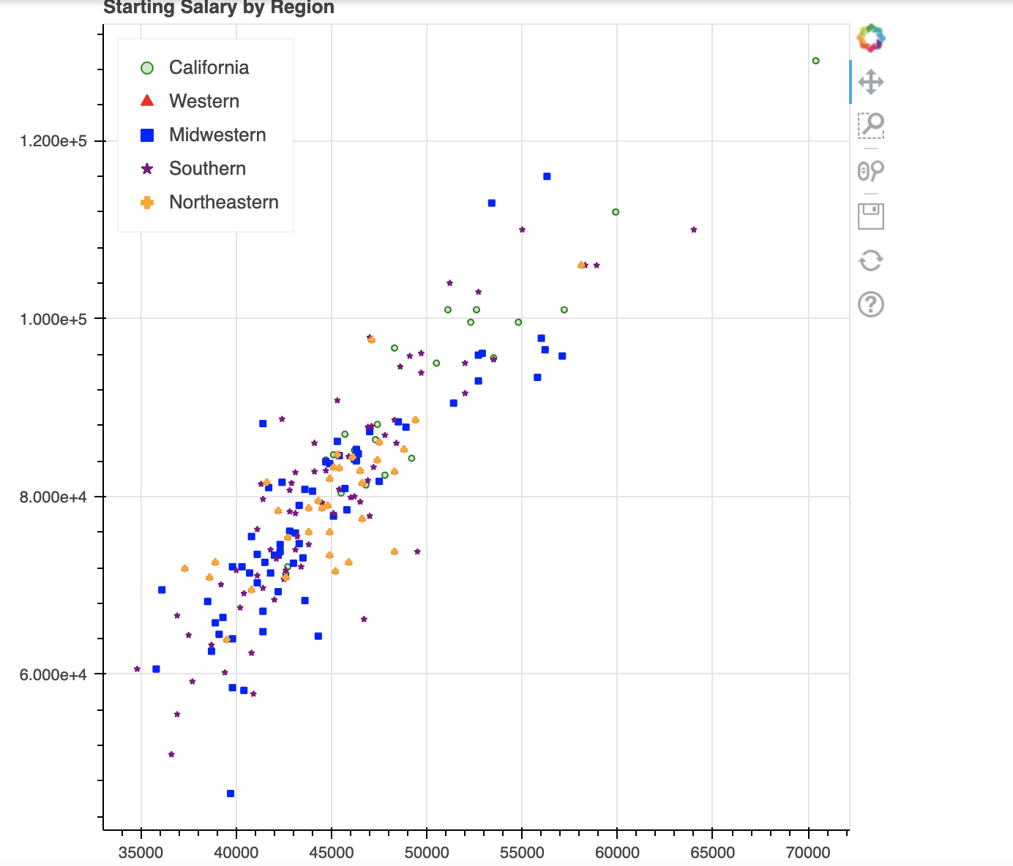

Slide 28
Stage 5: Communicate the Data
We used regression models, pairpolots, and other charts to model our data to make it meaningful for users.
Our results will be helpful for future graduates to estimate their salaries based on their major, college, and region.

Slide 29
Conclusions
All regions have similar starting salaries, but the Northeastern region has the highest Mid-Career 90th Percentile salary.
The Midwest has the lowest mid-career median salary.
The highest-paying majors are physician assistants and engineering-related majors.
All school types have similar starting salaries, but the Ivy League schools have the highest mid-career salaries.

